Slide 1
FACILITY LEVEL DATA QUALITY ASSURANCE PROCEDURES
FACILITY LEVEL DATA QUALITY ASSURANCE PROCEDURES
Michael de Klerk; Alfons Badi & Anna Jonas

Slide 2
Presentation Objectives
Key objective
Discuss approaches for strengthening regular verification of specific ART data, identification; implementation; and follow up of measures to enhance data quality and use at the facility level
Specific Objectives
Facility Reporting rate
Discuss alignment and integration of EDT/EPMS sub-systems
Discuss procedures for verification of the quality of reported data for selected ART indicators and enhancing the ability of staff to collect, use and report quality data
Discuss the causes of variances across National ART Reporting sub-systems.
Providing basic tools for facility data validation
Standardizing approaches to data quality validation at the facility level
Enhancing communication across the ART information sub-systems

Slide 3
Total number of active patients on ART by Region by Period

Slide 4
Data Quality Improvement (1)
Data quality improvement at facility level is critical for the HIV Program, Improved quality of care, accountability, planning and decision-making both at facility level and higher levels of the health system
National level: RM&E & Division of Pharmaceutical Services conducts data quality reviews every quarter using reports submitted by data clerks and ART Pharmacy staff
Facility Level: ART staff and ART pharmacy staff are supposed to conduct regular data quality reviews to compare patient statistics between the two systems and also to verify data with the primary source documents (PSDs)- the patient care booklets; correct discrepencies

Slide 5
Data Quality Improvement (2)
Results of the data verification exercise conducted for your Facility for March 2012 are shown in the table below

Slide 6
Data Quality Improvement (2)
Results of the data verification exercise conducted for your Facility for March 2012 are shown in the table below

Slide 7
Data Quality Improvement (2)
Results of the data verification exercise conducted for your Facility for March 2012 are shown in the table below

Slide 8
Data Quality Improvement (2)
Results of the data verification exercise conducted for your Facility for March 2012 are shown in the table below

Slide 9
Data Quality Improvement (2)
Results of the data verification exercise conducted for your Facility for March 2012 are shown in the table below

Slide 10
Data Quality Improvement (2)
Results of the data verification exercise conducted for your Facility for March 2012 are shown in the table below

Slide 11
EPMS/EDT active patient numbers variance magnitude by region

Slide 12
EPMS/EDT active patient numbers variance

Slide 13
EPMS/EDT LFTU Variance magnitude by Region

Slide 14
Why? facility level variances
Essentially the two sub-systems should not be much different. The EDT dispenses to the same patients managed by the ePMS
At the end of March 2012, national variance was -2%
Facility level absolute variance ranged from a high of 1571 to a low of 5

Slide 15
Reasons for facility level variances
Transfer out
Stopped by physician
New sites where you have ePMs without EDT

Slide 16
Reasons for facility level variance contd
Some health centres and clinics have patients receiving ARV medicines from the respective district hospital (hence captured in the EDT) but these patients may not be reflected in the district hospital’s ePMS and there’s no ePMS at these health centres/ clinics. (IMAI sites).
Outreach service points (updating files after outreach)
Failure by data clerks and pharmacy staff to use of the Facility Level Data Quality Verification tool to enable summary figures cross checks and patient status updates harmonisation between the two sub-systems.

Slide 17
Utilising the Facility Level Data Quality Verification tool
Div: Pharmaceutical Services report from from 2011/12 SSv indicate that only 7 out 29 (24%) visited utilized the verification tool
We are unable to assess if any intervention e.g whether the updating of records was carried out

Slide 18
What specific challenges do you face at your facility ?

Slide 19
Data Quality session outline
Data quality challenges in relation to PSD, EPMS and EDT
Alignment of key ART program data elements (EPMS/EDT)
Procedures and tools for facility level data quality assurance
Patient level completeness and consistency checks
Records reconciliation and sub-system communication tool
Variance quantification and explanation tool
Group work

Slide 20
Criteria/ dimensions of data quality
Validity or accuracy
Refers to data that have minimal errors e.g. transcription, interviewing bias, sampling errors etc
Reliability
Refers to stable/constant collection methodologies that are not influenced by personal, time and place factors
Integrity
Refers to the availability of adequate safeguards against intentional manipulation of data

Slide 21
Criteria/ dimensions of data quality
Completeness
Refers to an appropriately inclusive data system i.e. a system/ that contains adequate elements to enable performance of a given analysis
Timeliness
Refers to the availability of update information on time
Confidentiality
Refers to provisions for adequate security against un authorized disclosure

Slide 22
Key Data quality challenges in relation to the current ART information system
In adequate communication between complementary sub-systems
Complementary sub-systems that are based on different primary data sources
In adequate quality assurance mechanisms
Different levels of data management skills among staff
High work load
In adequate utilization of data

Slide 23
Suggested tools for assuring the quality of data at the facility level
The Facility Data Quality Assessment Form 1
Focuses on enabling the facility to regularly check the completeness and consistency of data elements across the PSD, EPMS, EDT and undertake measures to complete the missing details

Slide 24
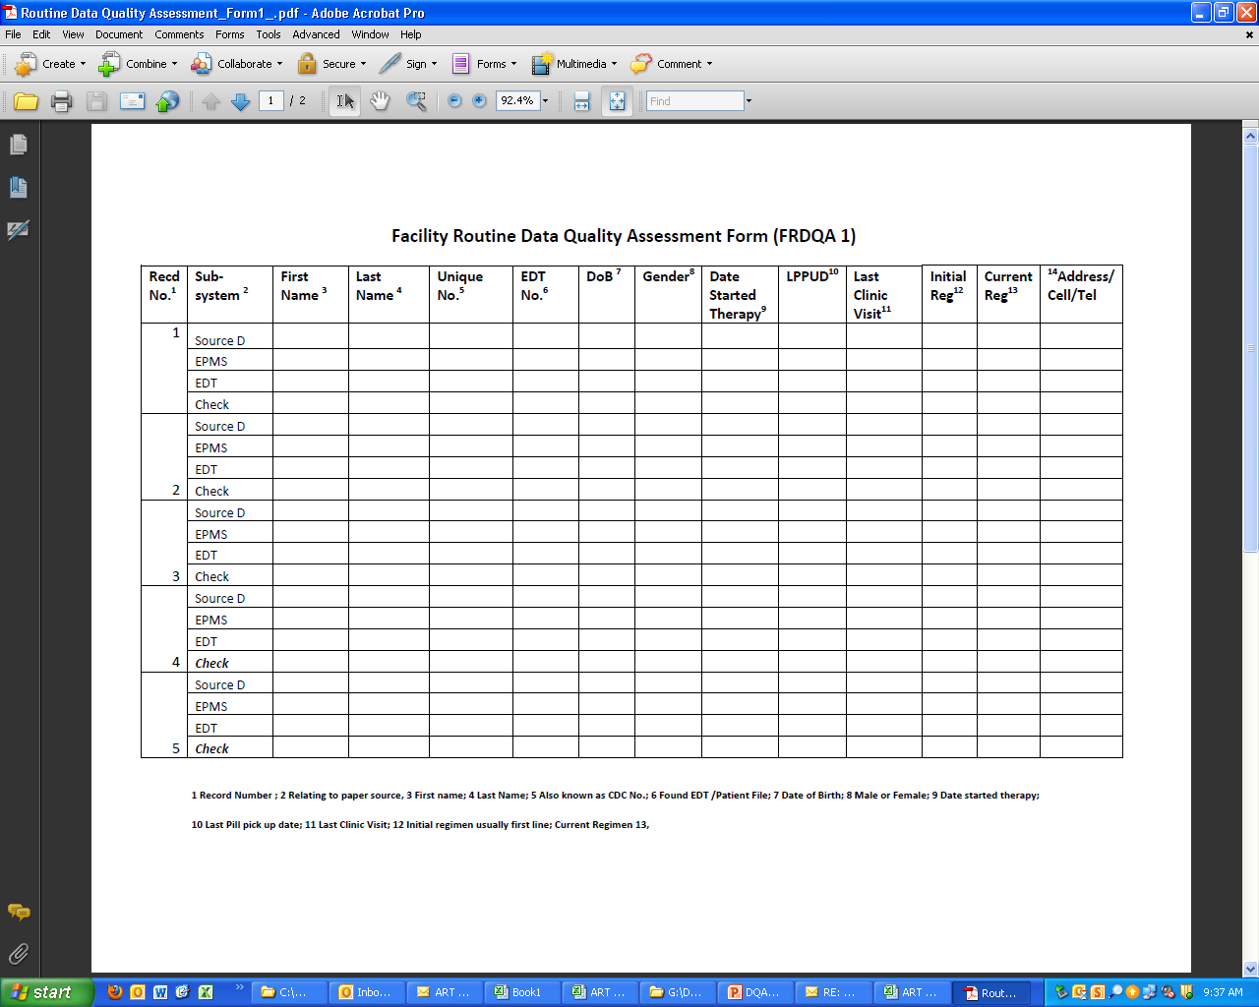

Slide 25
Suggested tools for assuring the quality of data at the facility level
Procedures for completing FRDQA 1
Randomly select at least 10% of new ART patients and perform steps 2 to 6 in collaboration colleagues from the Pharmacy depending on your patient load (by Data Clerk)
Complete columns 3 up to 14 for the Paper source document and EPMS (by the Data Clerk)
Complete columns 3 up to 14 for the EDT( by the Pharmacy)
Check for data elements that do not match (by the Pharmacy),
Meet with Data Clerk to resolve key patient data elements that do not match (Pharmacy and Data Clerk)
Make and file copies of completed FRDQA 1 in both the Pharmacy and the Data Office
Perform the completeness and consistency checks weekly.
Clinic Managers should check and ensure that at least 4 FRDQA 1 forms have been completed and filed in both the Pharmacy and the Data Clerks Office on monthly basis

Slide 26
Suggested tools for assuring the quality of data at the facility level
The Facility Data Quality Assessment Form 2
Focuses on enabling the pharmacy to communicate and collaboratively effect appropriate patient status changes to minimize variances across the key ART indicators between the two key systems

Slide 27
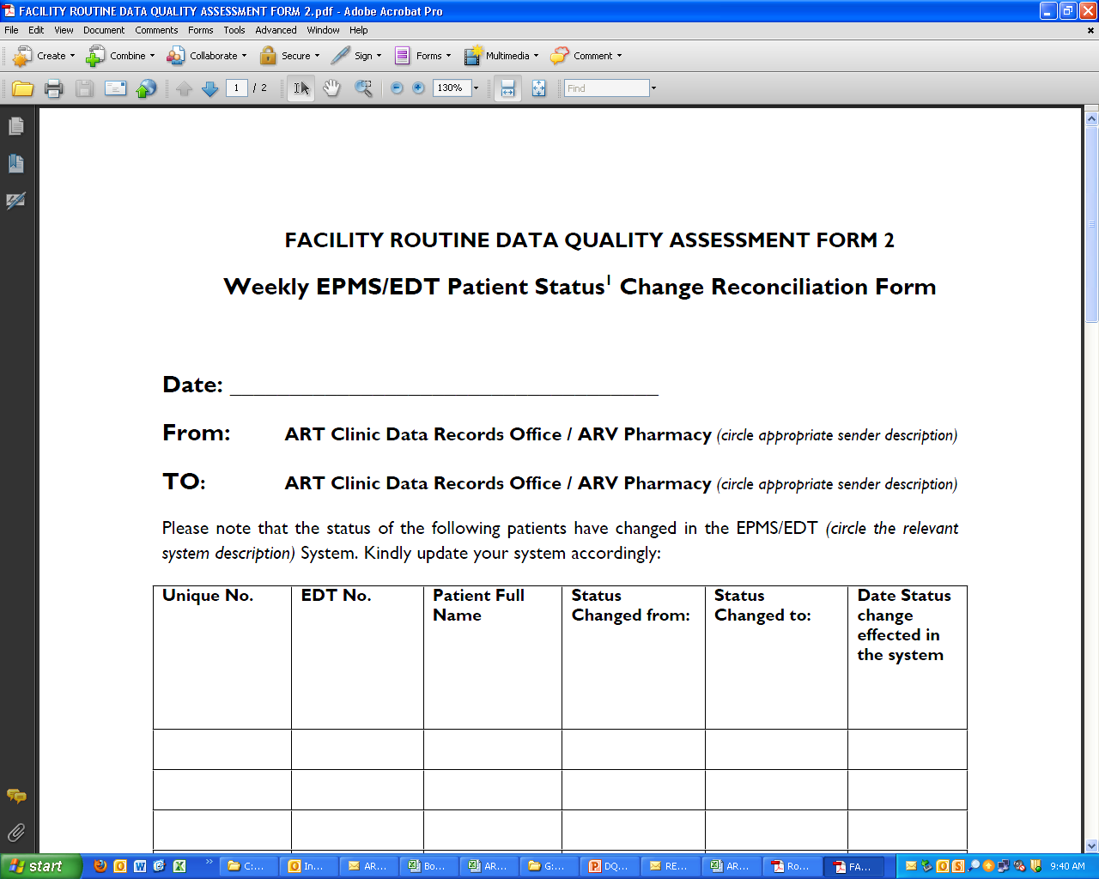

Slide 28
Procedures for completing FRDQA 2
Record each patient status change on FRQA 2 on weekly, and regularly send completed forms to your counterpart on weekly basis (Pharmacy and Data Clerk).
Receive and effect any status changes as requested by your counterpart on weekly basis.
Monthly checks by Clinic Managers to ensure that status changes requested by either the Pharmacy or the Data Clerk were affected.

Slide 29
Suggested tools for assuring the quality of data at the facility level
Facility Data Quality Assessment Form 3
Focuses on:
Enabling the facilities to validate aggregated numbers of key ART indicators across Primary Source Documents, the EPMS and the EDT
Determine how each of the two sub-systems vary from the paper source documents
Determine how the key ART indicators on the EPMS and the EDT vary from each other in relation to the primary source documents
Enable the sub-system operators to jointly investigate causes of variances on the key ART indicators and take appropriate actions

Slide 30
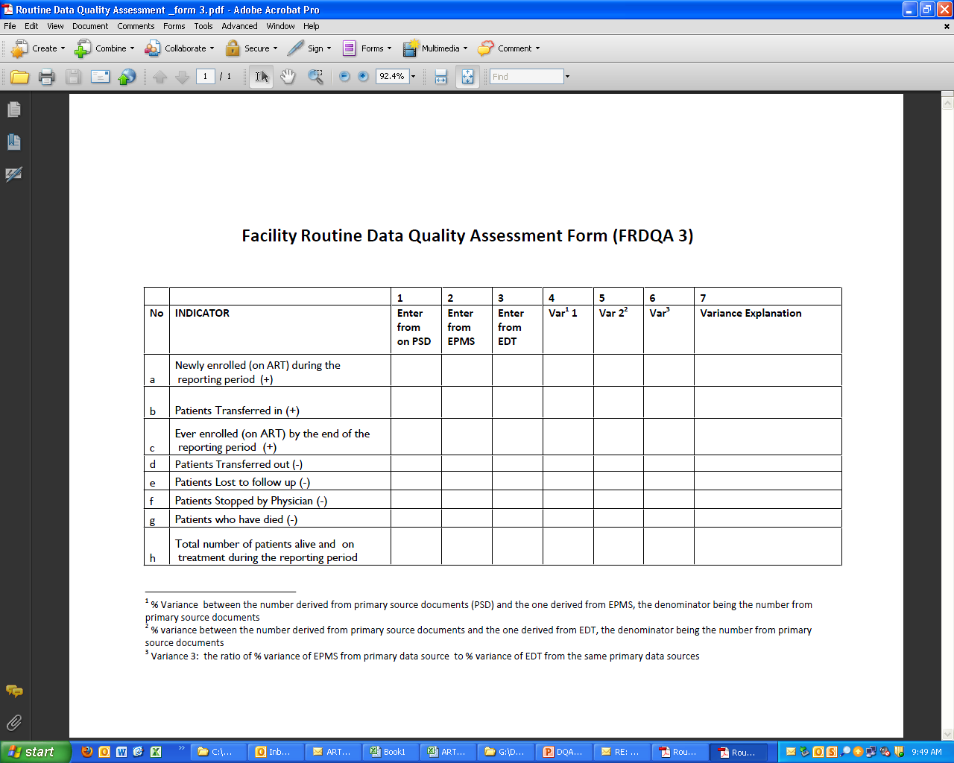

Slide 31
Procedures for completing FRDQA 3
Completion of column 1 of the FRDQA Form 3 for each of the selected key ART indicators from the ART Register by the Data Clerk
Running the relevant EPMS reports and completion of column 2 of the FRDQA Form 3 for each of the selected key ART indicators by the Data Clerk
Running the relevant EDT reports and completion of column 3 of the FRDQA Form 3 for each of the selected indicators by the ARV Pharmacist
Calculating the variance % 1 between figures derived from the source documents and EPMS, and recording in column 4 of the FRDQA Form 3 (Numerator = SD-EPMS; Denominator= Total number of patients recounted from your paper source documents) by the Data Clerk

Slide 32
Procedures for completing FRDQA 3
Calculating the variance % 2 of figures derived from the source documents and EDT, and recording in column 5 of the FRDQA Form 3 (Numerator = SD-EDT; Denominator= Total number of patients recounted from your paper source documents) by ARV Pharmacist
Record variance ratio in column 6 ( variance % 1 being numerator and variance % 2 being denominator) by the Clinic Manager
Facilitating a meeting to discuss and explain the variances and their possible causes, and taking appropriate actions to reduce the variances, documenting appropriate actions for follow up in subsequent meetings (Meeting to be arranged by the Clinic Manager)
Four copies of FRDQA 2 should be made once a meeting has been held and sent as follows: one copy with your EPMS Monthly Report to HQs, the other copy with the Pharmacy AMR to HQs (NMPC) and file remaining two copies with ARV Pharmacy and the ART Clinic Data Office.

Slide 33
Discussion and Group work Feedback
Questions & discussions

Slide 34
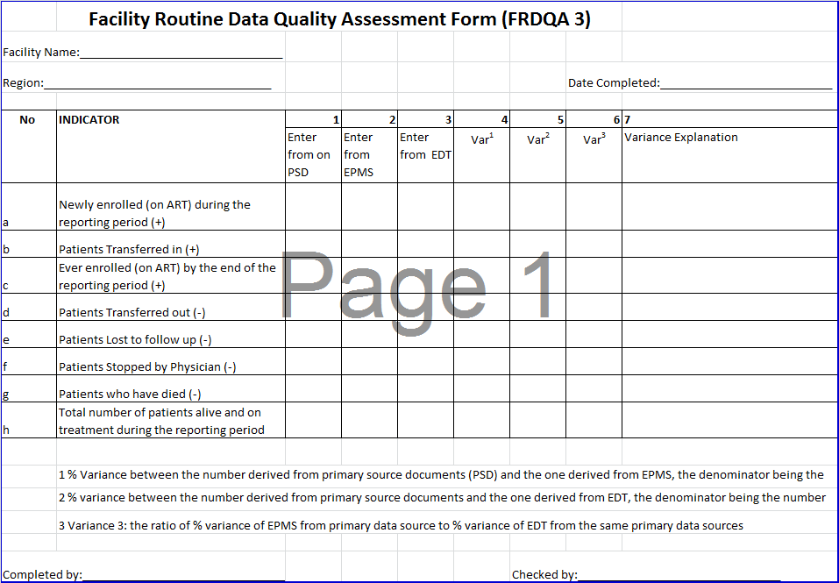
Way Forward
Ensure the use of Facility Routine Data Quality Assessment Form (FRDQA 1) and the Weekly EPMS/EDT Patient Status Change Reconciliation Form 2
Facility Routine Data Quality Assessment Form (FRDQA 3) have to reported to the National level on a monthly basis.

Slide 35
Way Forward
Jointly work together (ART, Pharmacy,) to address challenges with Routine monitoring within regions
All regions to implement joint ePMS/EDT review meetings Suggestions on type Analysis or indicators required on a monthly/ Quartely basis by Regions.(Technical support available from the National level)
Harmonize transport within regions (Strengthen Data capturing/ reporting, data quality assurance)
Implement Unique numbers across sub systems.

Slide 36
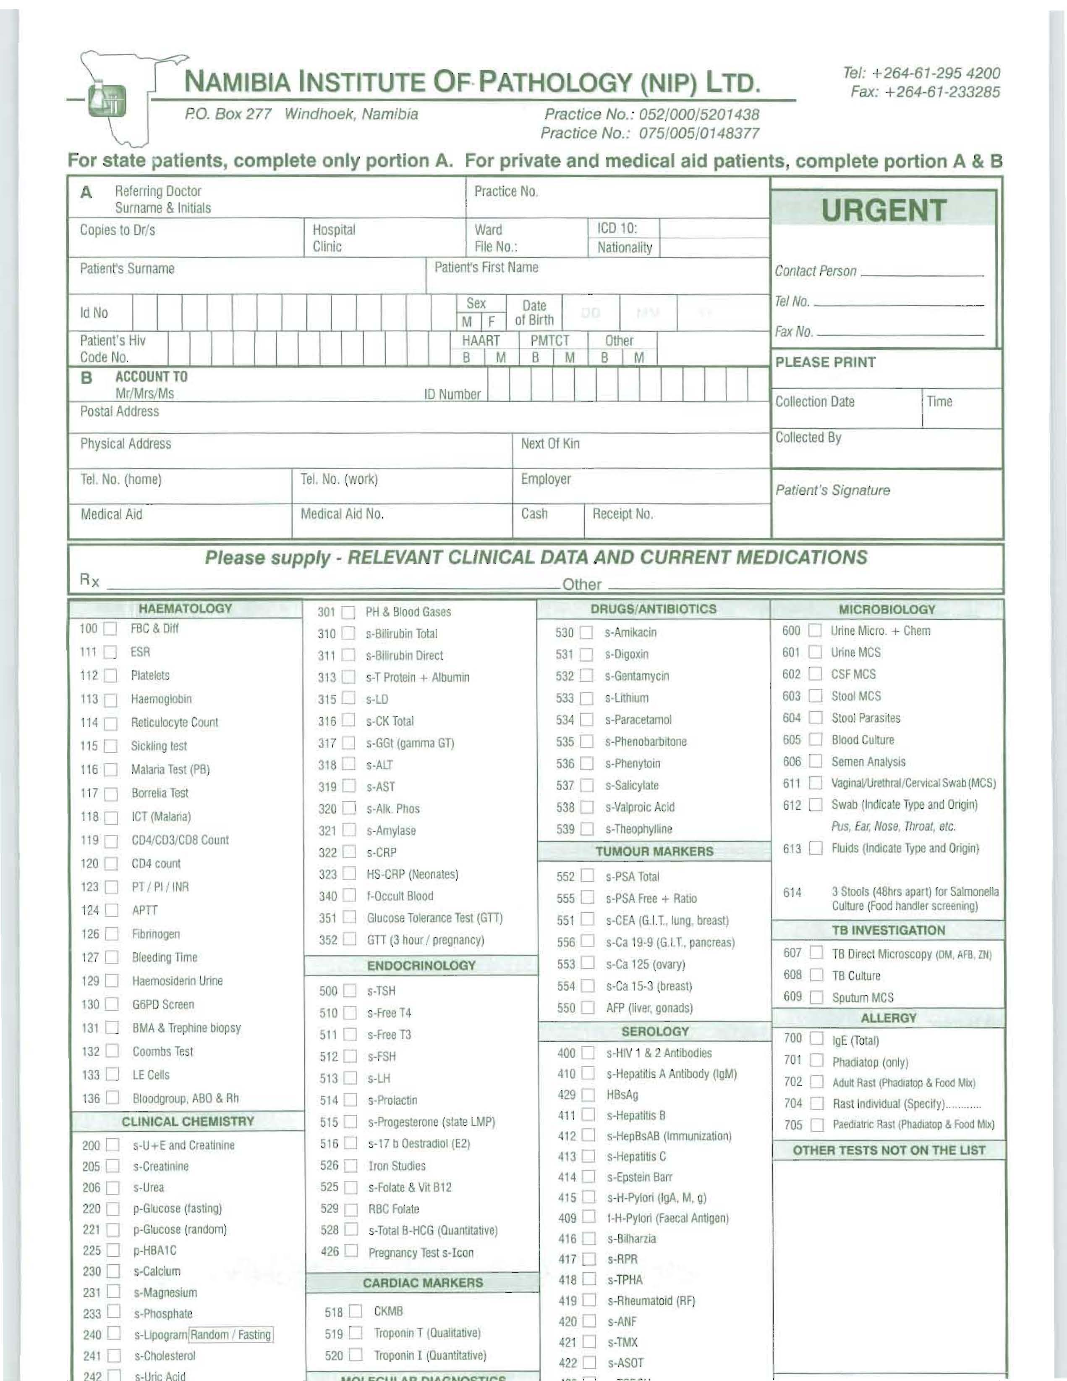
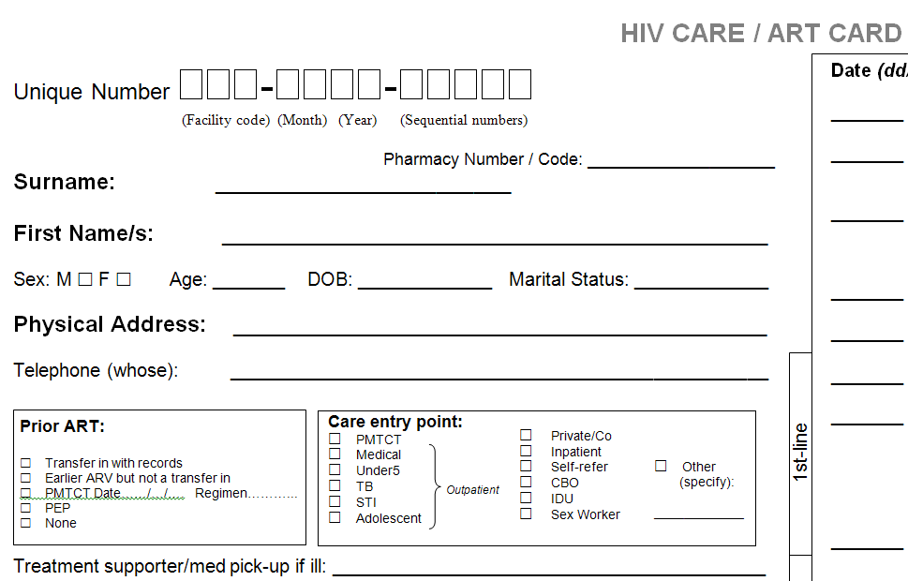
1
1
2

Slide 37
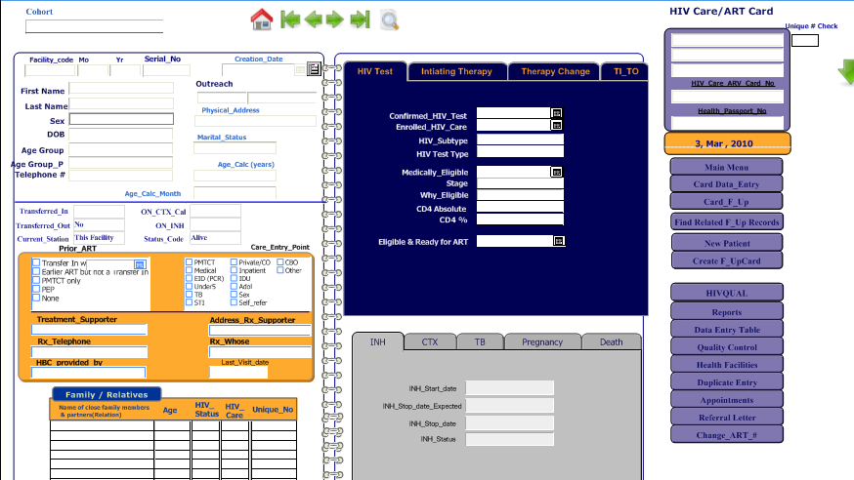
ePMS
1
2

Slide 38
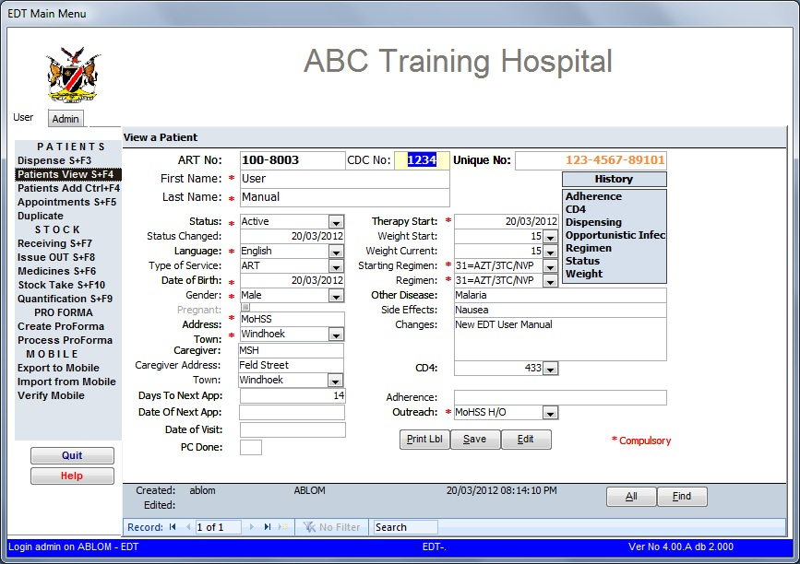
EDT
1
2

